Slide 1
internet of things

Slide 2
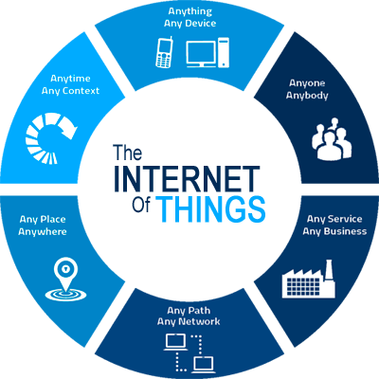
internet of things
The interconnection via the Internet of computing devices embedded in everyday objects, enabling them to send and receive data.
Examples: connected car, smart home devices, wearable technology and fitness trackers, connected health, and appliances (i.e. washer/dryers, robotic vacuums, ovens, or refrigerators) that use Wi-Fi for remote monitoring.

Slide 3
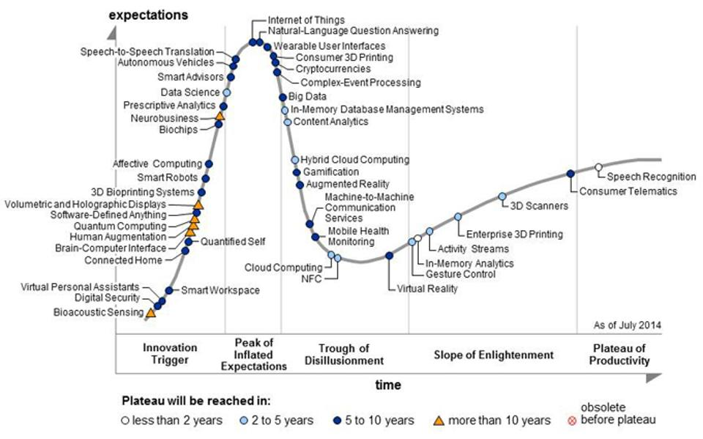
internet of things
Most hyped technology according to Gartner
Make everything communicate over the internet
Your thermostat
Your security cameras
Your fridge
Your vacuum
Your trashcan

Slide 4
applications of IOT
Smart cities utilize IoT by connecting the city together via the Internet
The city’s sensors monitor variables from the availability of parking spots to the fullness of garbage cans in order to make the city more efficient

Slide 5
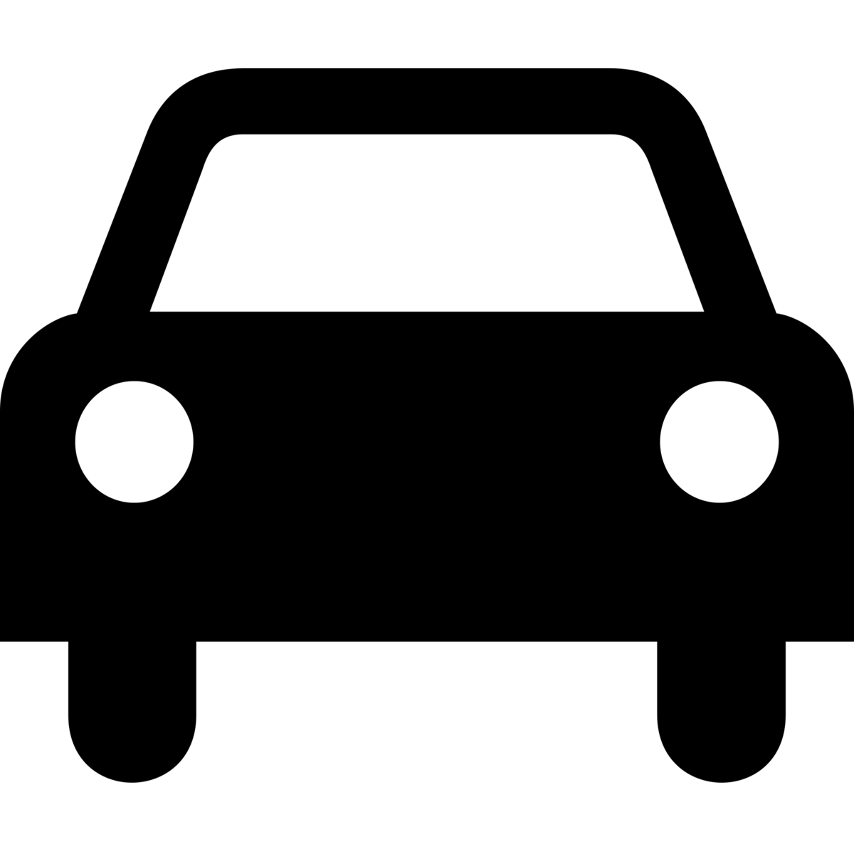
smart cities utilize IoT to increase efficiency
Citizens
Devices
Assets
Water supply networks
Schools & Libraries
WHAT FROM?
Power Plants
Law enforcement
Hospitals
Waste management
Traffic & transportation systems

Slide 6
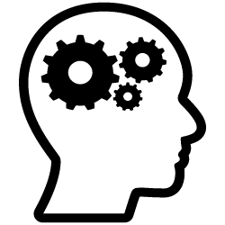
allow better decisions
Decreased costs of sensors and storing information
Internet of Things
Widespread use of apps and smartphones
HOW?
Machine learning
Growth of cloud computing
Increased access of analytical tools for gov’t officials

Slide 7
IoT applications
Rapid7 - IoT Security Researchers
Hacked multiple brands of baby monitors
Allowed anyone to view or control the cameras
Jeep Cherokee
Can be remotely controlled - including shutting down the engine
Notes:
https://www.wired.com/2015/07/hackers-remotely-kill-jeep-highway/
https://techcrunch.com/2015/10/24/why-iot-security-is-so-critical/

